Slide 1
Data R’sızları
Ahmet Turhal
İstem Akça Korkmaz
Mustafa Kurt
Serhan Süer
Ufuk Baysal
Turkey Food Prices
26 Dec 2018

Slide 2
Turkey Food Prices
Summary
Yearly Average Prices Per Food Type
We studied Turkey Food Prices data gathered from World Food Programme
We checked prices by category, by market then we analyzed foods in each category
Most significant price changes ;
milk powder for infants,
fresh fish, mutton meat,
olive oil,
rice, bread,
cocoa, instant coffee,
groundnuts
cucumbers, eggplants and onions
Reasons of Price increase:
Climate change
Natural causes
Currency rates crisis
Higher demand
Yearly Average Prices
Milk and Dairy
Cereals and Tubers
Meat, Fish and Eggs
Miscellaneous Food
Oil and Fats
Pulses and Nuts
Vegetables and Fruits
Conclusion

Slide 3
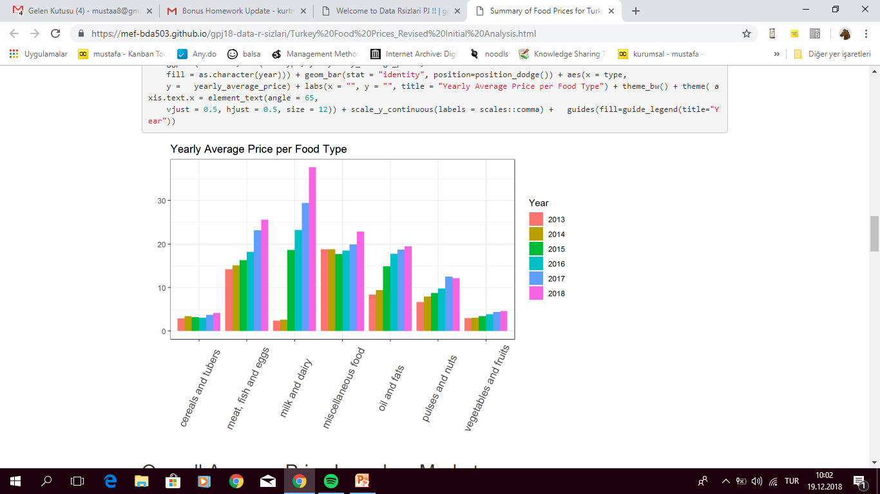
Yearly Average Prices Per Food Type
Cereals and tubers
Meat, Fish and Eggs
Milk and Dairy
Miscellaneous food
Oil and Fats
Pulses and Nuts
Vegetables and Fruits

Slide 4
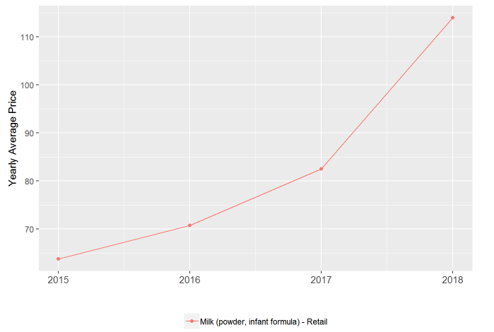
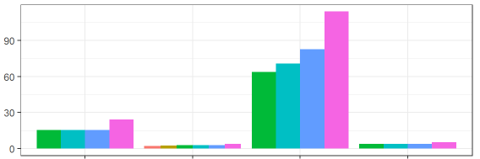
Yearly Average Price for Milk and Dairy
Cheese
Milk (Pasteurized)
Milk (powder, infant formula)
Yogurt
SGK

Slide 5
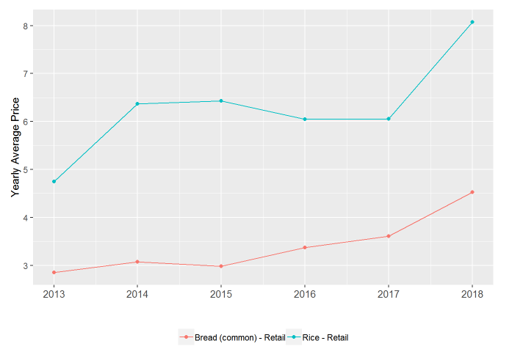
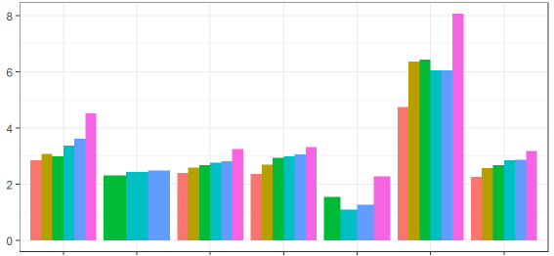
Yearly Average Price for Cereals and Tubers
Bread
Bread (Pita)
Bulgur
Pasta
Potatoes
Rice
Wheat Flour
Exchange Rates
Flour Price
Increase
weather
conditions
Decreased
supply

Slide 6
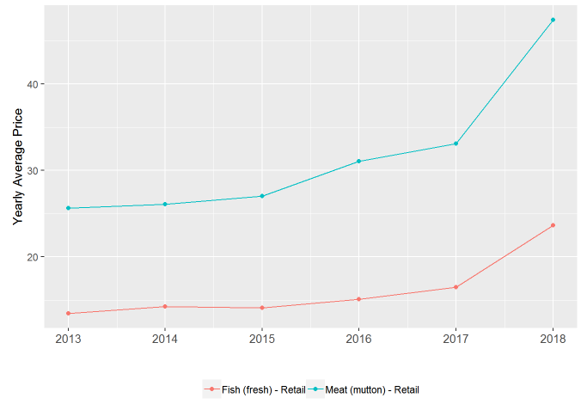
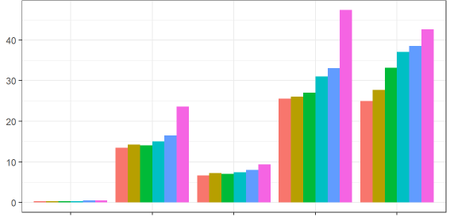
Yearly Average Price for Meat, Fish and Eggs
Eggs
Fish (fresh)
Meat (chicken)
Meat (mutton)
Meat (veal)
Exchange
Rates
Increased
Meat & chicken
price
Higher demand
for fish
weather
conditions
Decreased
Fish supply

Slide 7
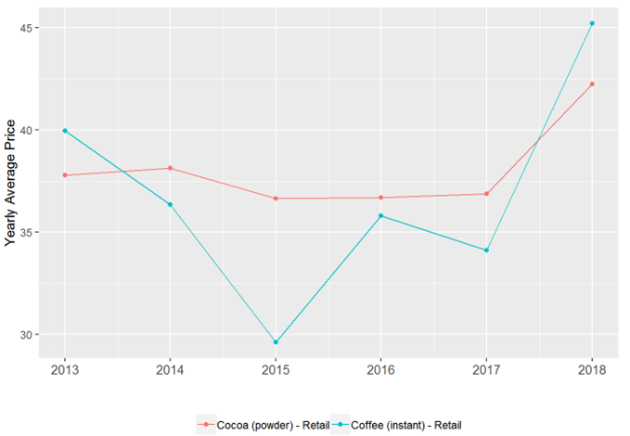
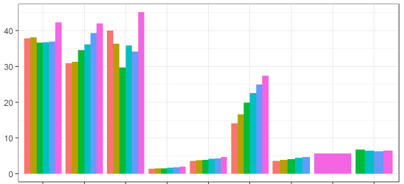
Yearly Average Price for Miscellaneous Food
Cocoa (powder)
Coffee
Coffee (Instant)
Salt
Sugar
Tea
Tea Green
Tea (Herbal)
Tomatoes (paste)
Decreased
supply
Increased demand
Climate Change

Slide 8
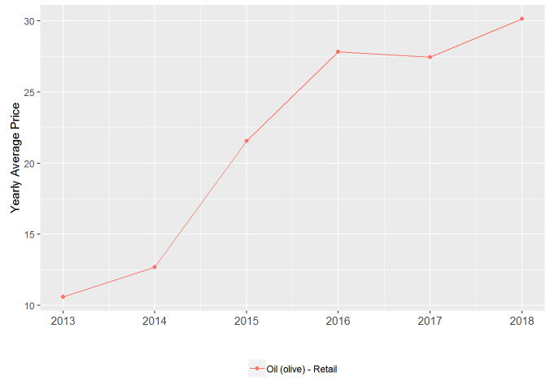
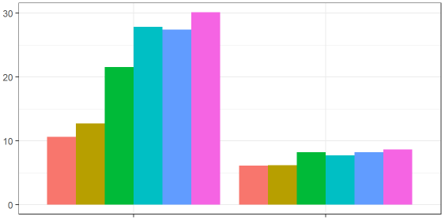
Yearly Average Price for Oil and Fats
Olive Oil
Sunflower Oil
Climate Change

Slide 9
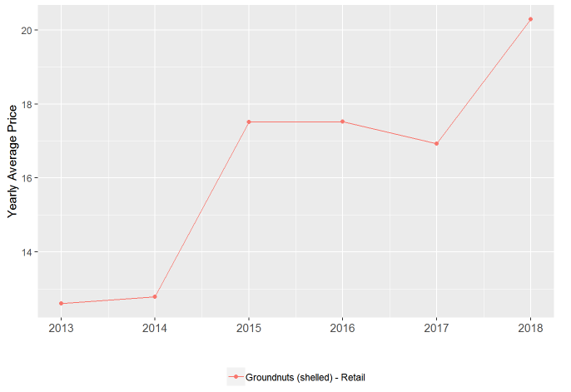
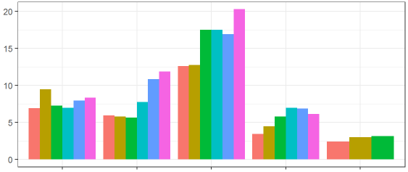
Yearly Average Price for Pulses and Nuts
Beans
Chickpeas
Groundnuts
Lentils
Peas
Lack of Production

Slide 10
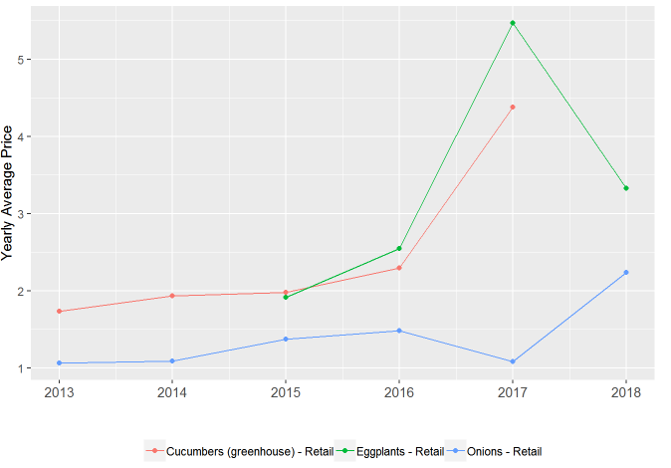
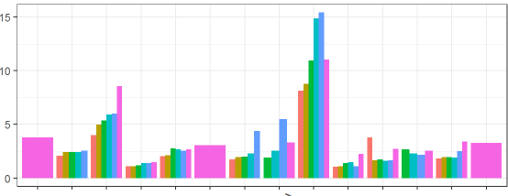
Yearly Average Price for Vegetables and Fruits
Apples
Bananas
Cabbage
Cauliflower
Cucumbers (greenhouse)
Eggplants
Garlic
Onions
Oranges
Spinach
Tomatoes
Zucchini
Cold Weather
Floods
Frozen
Onions

Slide 11
Conclusion
In line with our analysis, we can conclude that most of the food prices in Turkey seem to have increasing price trends majorly due to:
Climate change impact such as drought, excessive rain fall etc.
Natural causes such as pest infestation
Current currency rates crisis
Higher demand due to increasing population
Insufficient supply as oppose to high demand
Price changes all over the world, especially for imported ones
In addition, we can say that 2018 food prices in Turkey have increased overall with a few exceptions in line with the reasons explained
above.

